Slide 1
Project Overview
FoodieAware
Oregon Food Truck Association
By: Tanel Helmik

Slide 2
Project Goals
Provide a connection between food truck and foodie.
Provide an android app to the foodies. Most use an android device.
Provide an apple iOS app to food trucks because they use square to receive payments.

Slide 3
Description
A multi device application that will allow foodies to see truck locations and their open/closed status.
A cool foodie app that shows them where the trucks are and lets trucks tell people when they are open or closed.

Slide 4
Competitive Analysis
Competitors
None I can find
Strengths
This kind of app doesn’t exist for this purpose yet.
Weaknesses
New app and I am by myself.

Slide 5
Technology
New technology being used
Azure single database. Android Studio or Xamarin for Android app. iOS seems to require an apple product to code.

Slide 6
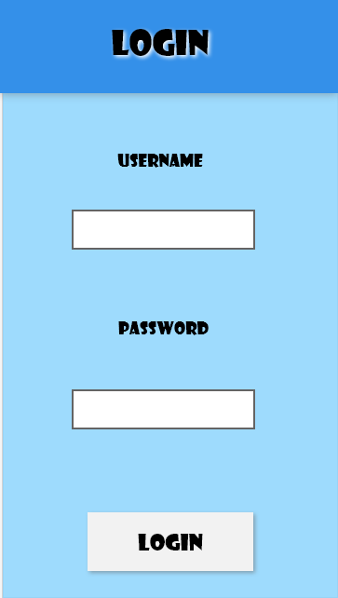
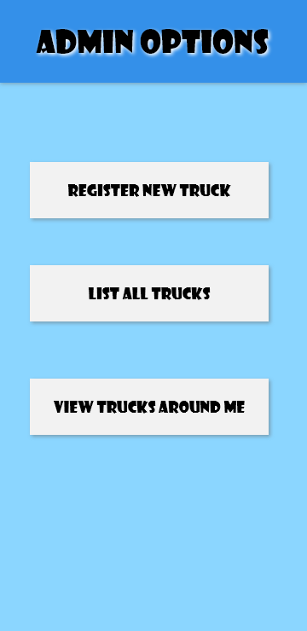
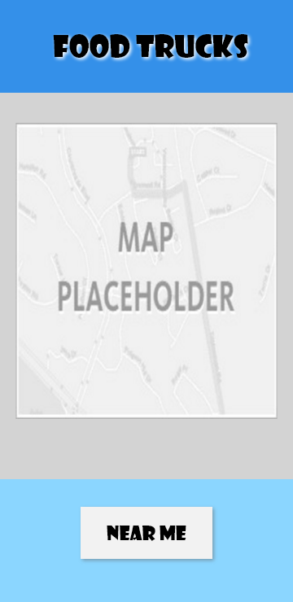
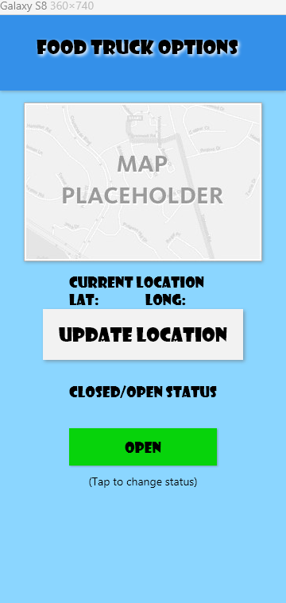
Layouts

Slide 7
Current Status
Working on documentation and organizing what requirements are needed and what the displays could look like.
This is a big project and I see that it could be a senior project and I actually plan to finish this project.

Slide 8
Related Documents
Marketing plan
Just talking to Lea at the moment.
Budget
Currently None
Post-mortem
I have a project requirements word document. Any Questions?

